Slide 1
Discrete Mathematics
(BCSC1010)
Module 1
Mathematical Induction

Slide 2
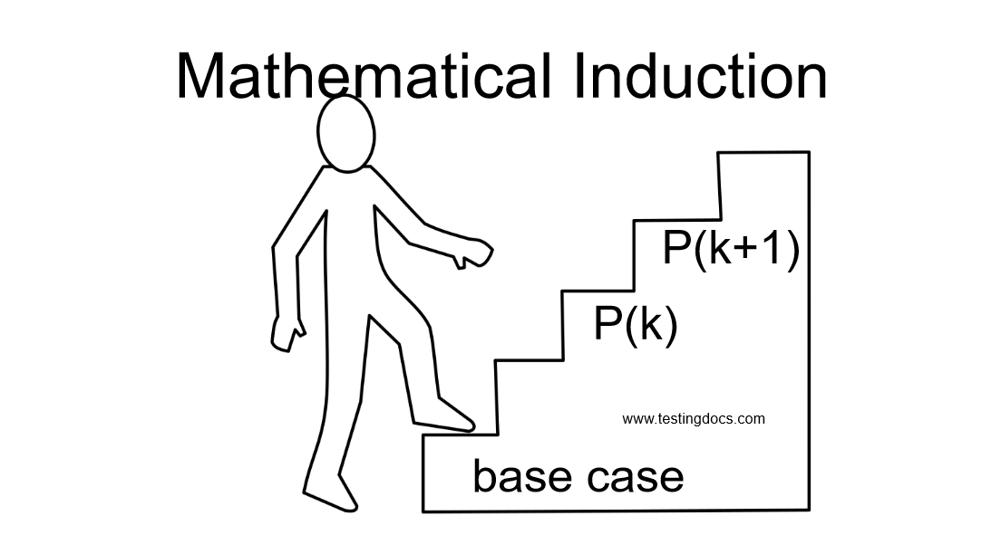
Mathematical Induction
Definition
Mathematical Induction is a mathematical technique which is used to prove a statement, a formula or a theorem is true for every natural number.

Slide 3
Principle of Mathematical Induction
Hypothesis: P(n) is true for all integers n≥b
To prove that P(n) is true for all integers n≥b (*), where P(n) is a propositional function, follow the steps:
Basic Step or Base Case: Verify that P(b) is true;
Inductive Hypothesis: assume P(k) is true for some k ≥ b;
Inductive Step: Show that the conditional statement P(k) →P(k+1) is true for all integers k ≥ b. This can be done by showing that under the inductive hypothesis that P(k) is true, P(k+1) must also be true.
(*) quite often b=1, but b can be any integer number.

Slide 4
Mathematical Induction
Use induction to prove that the sum of the first n odd integers is n². What’s the hypothesis?
1 – Hypothesis: P(n) – sum of first n odd integers = n².
2 - Base case (n=1): the sum of the first 1 odd integer is 1².
Since 1 = 1²
3 - Assume P(k): the sum of the first k odd ints is k².
1 + 3 + … + (2k - 1) = k²
Inductive hypothesis
4 – Inductive Step: show that ∀(k) P(k) → P(k+1), assuming P(k).
How?
By inductive hypothesis
P(k+1)= 1 + 3 + … + (2k-1) + (2k+1) =
k² + (2k + 1)
p(k)
= (k+1)²
QED

Slide 5
Example
Use induction to prove that the 1 + 2 + 2² + … + 2^{n} = 2^{n+1} - 1 for all non-negative integers n.
1 – Hypothesis?
P(n) = 1 + 2 + 2² + … + 2^{n} = 2 ^{n+1} – 1
for all non-negative integers n.
2 - Base case?
n = 0 1⁰ = 2¹-1.
not n=1! The base case
can be negative, zero,
or positive
Inductive hypothesis
3 – Inductive Hypothesis
Assume P(k) = 1 + 2 + 2² + … + 2^{k} = 2 ^{k+1} – 1

Slide 6
Example
4 – Inductive Step: show that ∀(k) P(k) → P(k+1), assuming P(k).
How?
P(k+1)= 1 + 2 + 2² + … + 2^{k}+ 2^{k+1} = (2^{k+1} – 1) + 2^{k+1}
By inductive hypothesis
p(k)
= 2 2^{k+1} - 1
P(k+1) = 2^{k+2} - 1
= 2^{(k+1)+1} - 1

Slide 7
Example
Prove that 1⋅1! + 2⋅2! + … + n⋅n! = (n+1)! - 1, ∀ positive integers
1 – Hypothesis P(n) = 1⋅1! + 2⋅2! + … + n⋅n! = (n+1)! - 1, ∀ positive integers
2 - Base case (n=1): 1⋅1! = (1+1)! - 1?
  1⋅1! = 1 and 2! - 1 = 1
Inductive hypothesis
3 - Assume P(k): 1⋅1! + 2⋅2! + … + k⋅k! = (k+1)! - 1
4 – Inductive Step - show that ∀k P(k) → P(k+1), assuming P(k).
i.e. prove that 1⋅1! + … + k⋅k! + (k+1)(k+1)! = (k+2)! – 1, assuming P(k)
1⋅1! + … + k⋅k! + (k+1)(k+1)! =
(k+1)! - 1 + (k+1)(k+1)!
= (1 + (k+1))(k+1)! - 1
= (k+2)(k+1)! - 1
= (k+2)! - 1

Slide 8
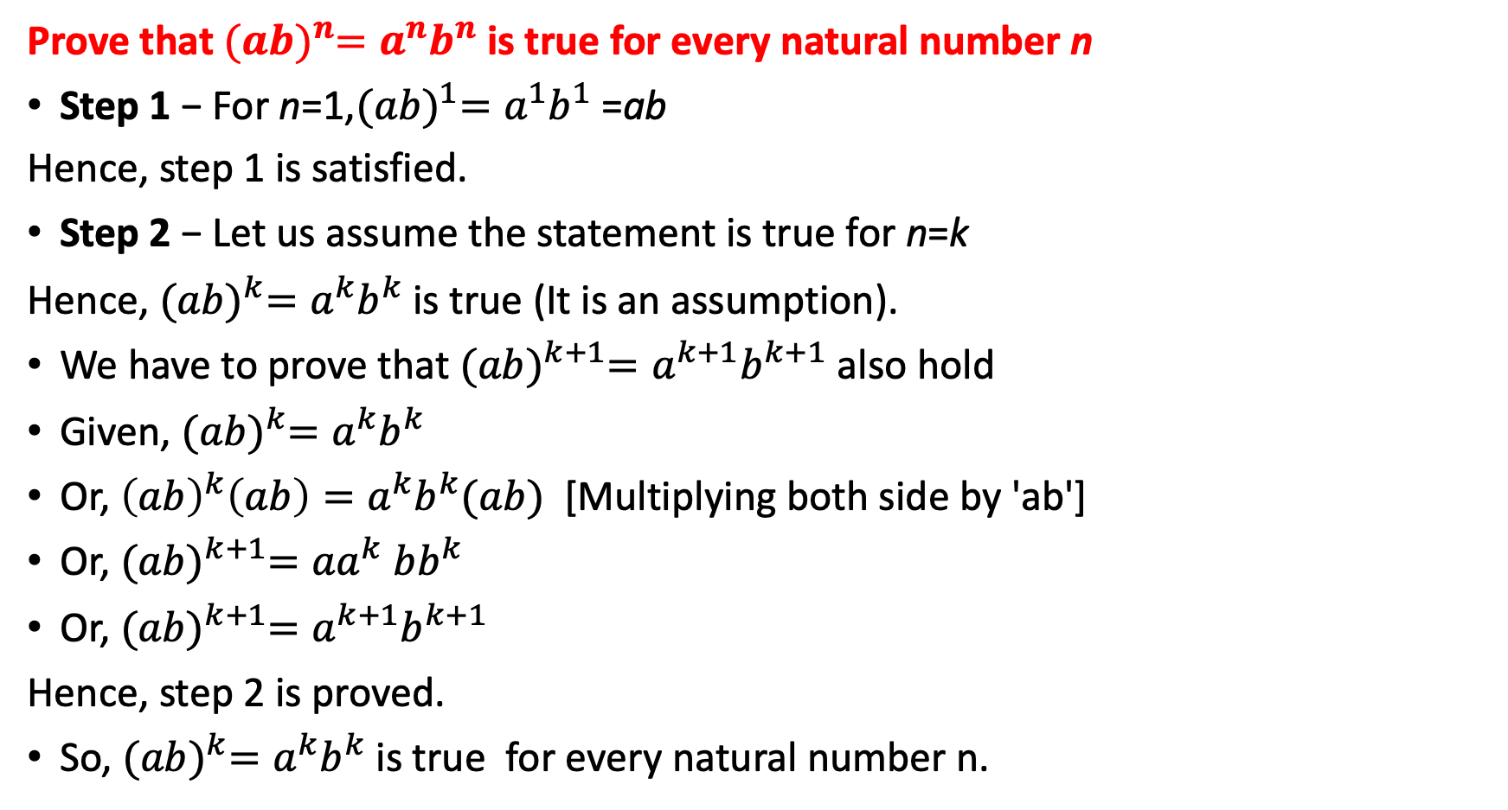
Example
Prove that ${(ab)}^{n}=a^{n}b^{n}$ is true for every natural number n
Step 1 − For n=1,${(ab)}^{1}=a^{1}b^{1}$=ab
Hence, step 1 is satisfied.
Step 2 − Let us assume the statement is true for n=k
Hence, ${(ab)}^{k}=a^{k}b^{k}$is true (It is an assumption).
We have to prove that ${(ab)}^{k+1}=a^{k+1}b^{k+1}$ also hold
Given, ${(ab)}^{k}=a^{k}b^{k}$
Or, ${\left(ab\right)}^{k}\left(ab\right)=a^{k}b^{k}(ab)$[Multiplying both side by 'ab']
Or, ${(ab)}^{k+1}={aa}^{k} bb^{k}$
Or, ${(ab)}^{k+1}=a^{k+1}b^{k+1}$
Hence, step 2 is proved.
So, ${(ab)}^{k}=a^{k}b^{k}$is true for every natural number n.

Slide 9
Strong Induction
Strong Induction is another form of mathematical induction. Through this induction technique, we can prove that a propositional function, P(n) is true for all positive integers, n, using the following steps:-
Step 1(Base step) − It proves that the initial proposition P(1) true.
Step 2(Inductive step) − It proves that the conditional statement [P(1)∧P(2)∧P(3)∧⋯∧P(k)]→P(k+1)
is true for positive integers k.

Slide 10
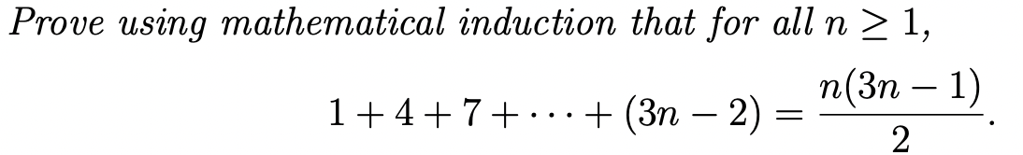
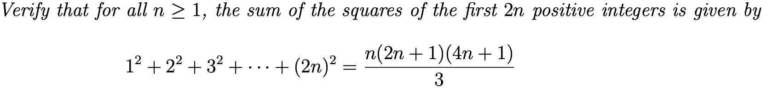
Exercise

